Slide 1
Chapter 4: Loops

Slide 2
Chapter Goals
To implement while and for loops
To hand-trace the execution of a program
To become familiar with common loop algorithms
To understand nested loops
To implement programs that read and process data sets
To use a computer for simulations
In this chapter, you will learn about loop statements in Python, as well as techniques for writing programs that simulate activities in the real world.

Slide 3
Contents
The while loop
Problem Solving: Hand-Tracing
Application: Processing Sentinels
Problem Solving: Storyboards
Common Loop Algorithms
The for loop
Nested loops
Processing Strings
Application: Random Numbers and Simulation
Graphics: Digital Image Processing
Problem Solving: Solve a Simpler Problem First

Slide 4
The while Loop

Slide 5
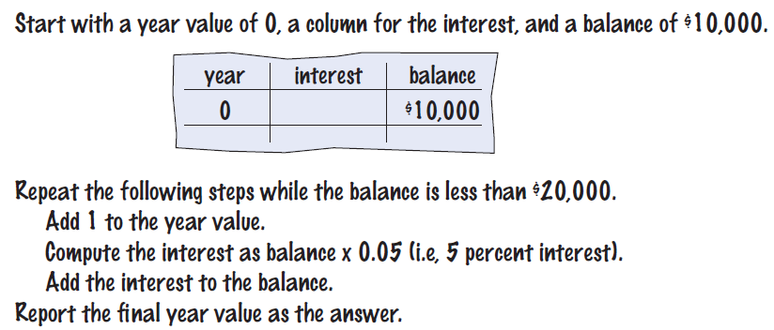
The while Loop
Examples of loop applications
Calculating compound interest
Simulations, event driven programs
Drawing tiles…
Compound interest algorithm (Chapter 1)
Steps

Slide 6
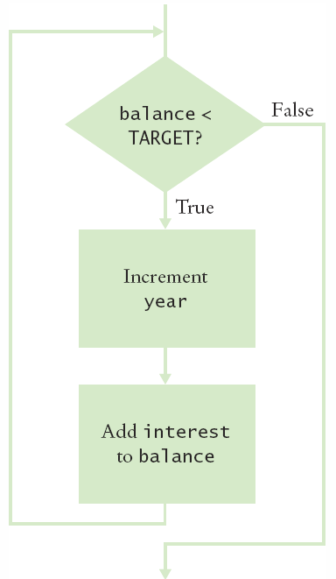
Planning the while Loop
balance = 10.0
target = 100.0
year = 0
rate = 0.025
while balance < TARGET :
year = year + 1
interest = balance * RATE/100
balance = balance + interest
A loop executes instructions repeatedly while a condition is True.

Slide 7
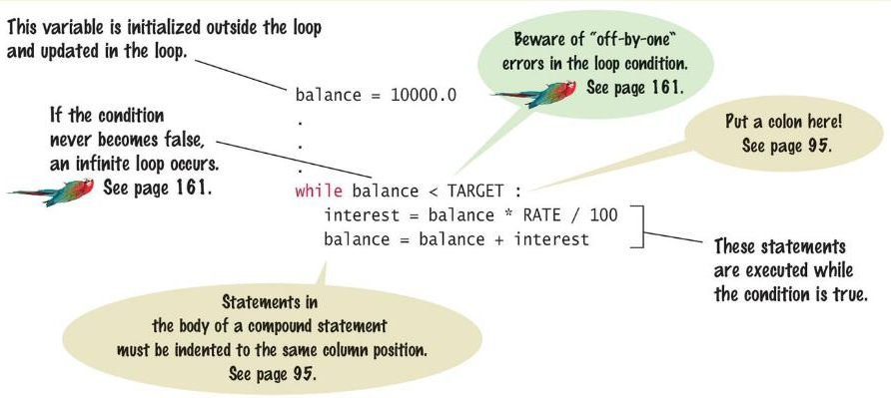
Syntax: while Statement

Slide 8
Count-Controlled Loops
A while loop that is controlled by a counter
counter = 1 # Initialize the counter
while counter <= 10 : # Check the counter
print(counter)
counter = counter + 1 # Update the loop variable

Slide 9
Event-Controlled Loops
A while loop that is controlled by a counter
balance = INITIAL_BALANCE # Initialize the loop variable
while balance <= TARGET: # Check the loop variable
year – year + 1
balance = balance * 2 # Update the loop variable

Slide 10
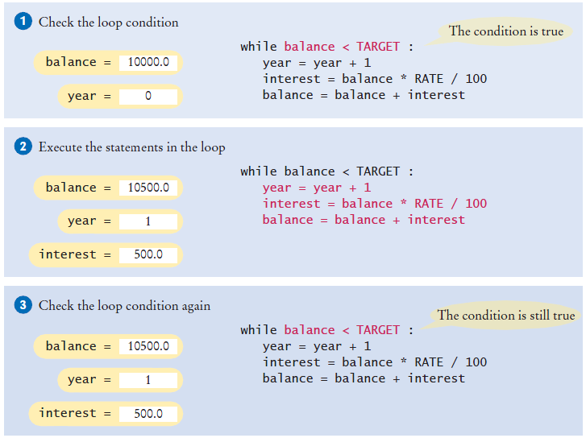
Execution of the Loop

Slide 11
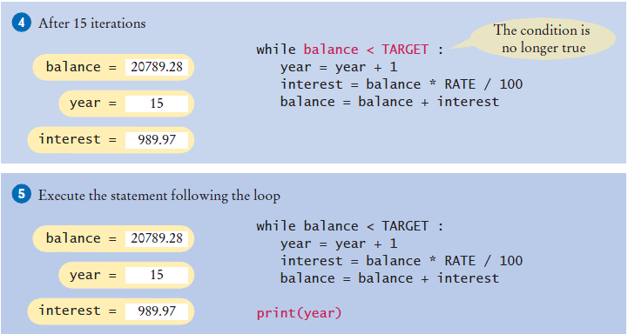
Execution of the Loop (2)

Slide 12
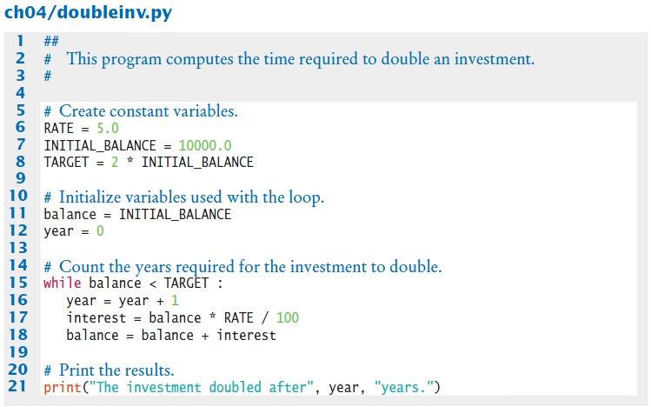
Doubleinv.py
Declare and initialize a variable outside of the loop to count year
Increment the year variable each time through

Slide 13
Investment Example
Open the file:
Doubleinv.py
Run the program with several test cases
The program will prompt you for a rate
Enter a mix of valid and invalid rates

Slide 14
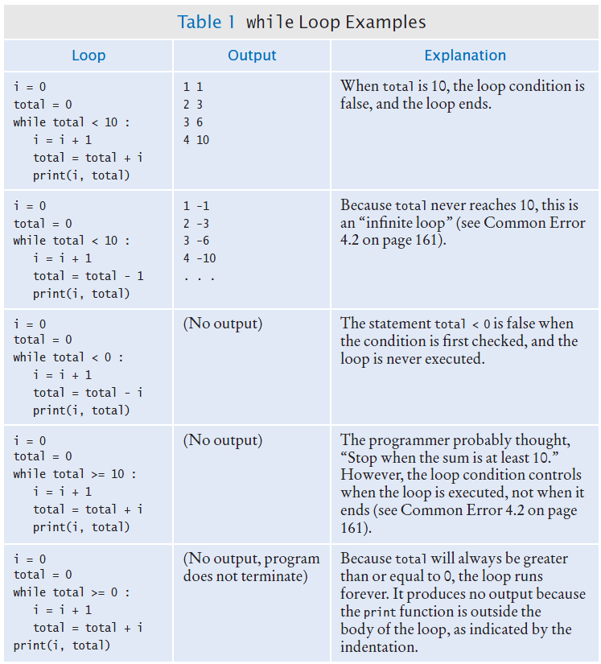
while Loop Examples

Slide 15
while Loop Examples (2)

Slide 16
Common Error: Incorrect Test Condition
The loop body will only execute if the test condition is True.
If bal is initialized as less than the TARGET and should grow until it reaches TARGET
Which version will execute the loop body?
while bal >= TARGET :
year = year + 1
interest = bal * RATE
bal = bal + interest
while bal < TARGET :
year = year + 1
interest = bal * RATE
bal = bal + interest

Slide 17
Common Error: Infinite Loops
The loop body will execute until the test condition becomes False.
What if you forget to update the test variable?
bal is the test variable (TARGET doesn’t change)
You will loop forever! (or until you stop the program)
while bal < TARGET :
year = year + 1
interest = bal * RATE
bal = bal + interest

Slide 18
Common Error: Off-by-One Errors
A ‘counter’ variable is often used in the test condition
Your counter can start at 0 or 1, but programmers often start a counter at 0
If I want to paint all 5 fingers on one hand, when I am done?
If you start at 0, use “<“ If you start at 1, use “<=“
0, 1, 2, 3, 4 1, 2, 3, 4, 5
finger = 0
FINGERS = 5
while finger < FINGERS :
# paint finger
finger = finger + 1
finger = 1
FINGERS = 5
while finger <= FINGERS :
# paint finger
finger = finger + 1

Slide 19
Hand Tracing Loops

Slide 20
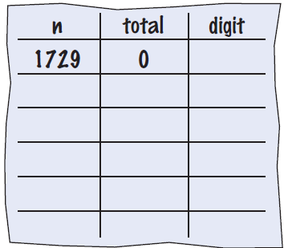
Hand-Tracing Loops
Example: Calculate the sum of digits (1+7+2+9)
Make columns for key variables (n, total, digit)
Examine the code and number the steps
Set variables to state before loop begins

Slide 21
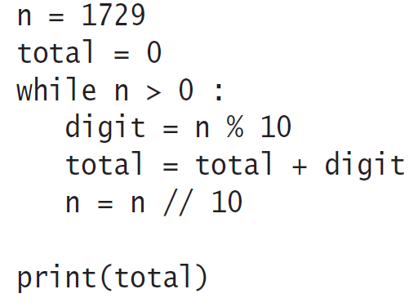
Tracing Sum of Digits
Start executing loop body statements changing variable values on a new line
Cross out values in previous line

Slide 22
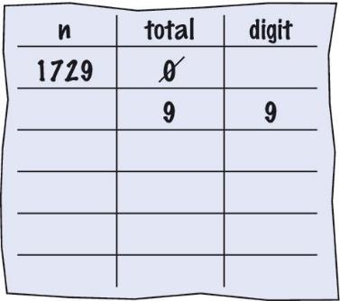
Tracing Sum of Digits
Continue executing loop statements changing variables
1729 / 10 leaves 172 (no remainder)

Slide 23
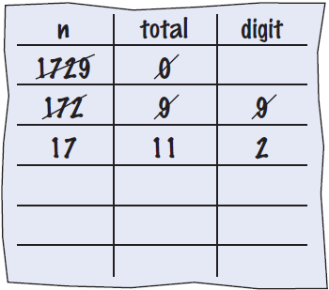
Tracing Sum of Digits
Test condition. If True, execute loop again
Variable n is 172, Is 172 > 0?, True!
Make a new line for the second time through and update variables

Slide 24
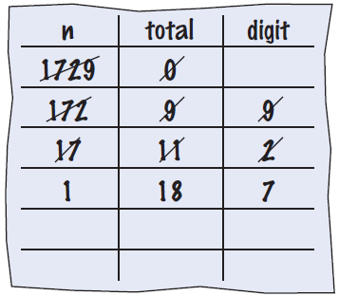
Tracing Sum of Digits
Third time through
Variable n is 17 which is still greater than 0
Execute loop statements and update variables

Slide 25
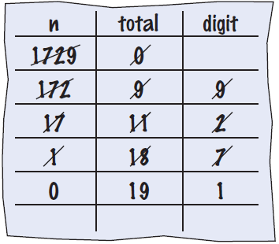
Tracing Sum of Digits
Fourth loop iteration:
Variable n is 1 at start of loop. 1 > 0? True
Executes loop and changes variable n to 0 (1/10 = 0)

Slide 26
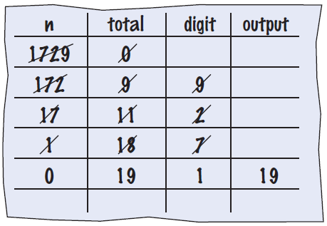
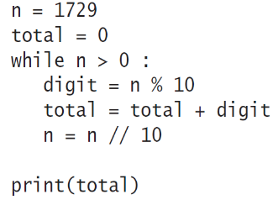
Tracing Sum of Digits
Because n is 0, the expression(n > 0) is False
Loop body is not executed
Jumps to next statement after the loop body
Finally prints the sum!

Slide 27
Summary of the while Loop
while loops are very common
Initialize variables before you test
The condition is tested BEFORE the loop body
This is called pre-test
The condition often uses a counter variable
Something inside the loop should change one of the variables used in the test
Watch out for infinite loops!

Slide 28
Sentinel Values

Slide 29
Processing Sentinel Values
Sentinel values are often used:
When you don’t know how many items are in a list, use a ‘special’ character or value to signal the “last” item
For numeric input of positive numbers, it is common to use the value -1
A sentinel value denotes the end of a data set, but it is not part of the data.
salary = 0.0
while salary >= 0 :
salary = float(input())
if salary >= 0.0 :
total = total + salary
count = count + 1

Slide 30
Averaging a Set of Values
Declare and initialize a ‘total’ variable to 0
Declare and initialize a ‘count’ variable to 0
Declare and initialize a ‘salary’ variable to 0
Prompt user with instructions
Loop until sentinel value is entered
Save entered value to input variable (‘salary’)
If salary is not -1 or less (sentinel value)
Add salary variable to total variable
Add 1 to count variable
Make sure you have at least one entry before you divide!
Divide total by count and output.
Done!

Slide 31
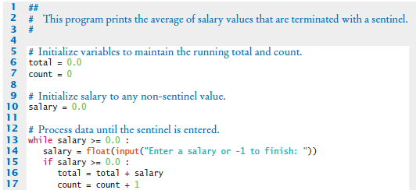
Sentinel.py (1)
Outside the while loop: declare and initialize variables to use
Since salary is initialized to 0, the while loop statements will execute at least once
Input new salary and compare to sentinel
Update running total and count (to calculate the average later)

Slide 32

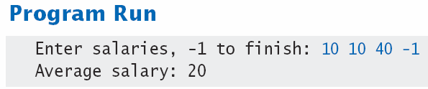
Sentinel.py (2)
Prevent divide by 0
Calculate and output the average salary using the total and count variables

Slide 33
Sentinel Example
Open the file:
Sentinal.py
Notice the use of the IF() test inside the while loop
The IF() checks to make sure we are not processing the sentinel value

Slide 34
Priming Read
Some programmers don’t like the “trick” of initializing the input variable with a value other than a sentinel.
# Set salary to a value to ensure that the loop
# executes at least once.
salary = 0.0
while salary >= 0 :
An alternative is to change the variable with a read before the loop.
salary = float(input("Enter a salary or -1 to finish: "))
while salary >= 0 :

Slide 35
Modification Read
The input operation at the bottom of the loop is used to obtain the next input.
# Priming read
salary = float(input("Enter a salary or -1 to finish: "))
while salary >= 0.0 :
total = total + salary
count = count + 1
# Modification read
salary = float(input("Enter a salary or -1 to finish:
"))

Slide 36
Boolean Variables and Sentinels
A boolean variable can be used to control a loop
Sometimes called a ‘flag’ variable
done = False
while not done :
value = float(input("Enter a salary or -1 to finish: "))
if value < 0.0:
done = True
else :
# Process value
Initialize done so that the loop will execute
Set done ‘flag’ to True if sentinel value is found

Slide 37
Storyboards

Slide 38
Storyboards
One useful problem solving technique is the use of storyboards to model user interaction. It can help answer:
What information does the user provide, and in which order?
What information will your program display, and in which format?
What should happen when there is an error?
When does the program quit?
A storyboard consists of annotated sketches for each step in an action sequence.

Slide 39
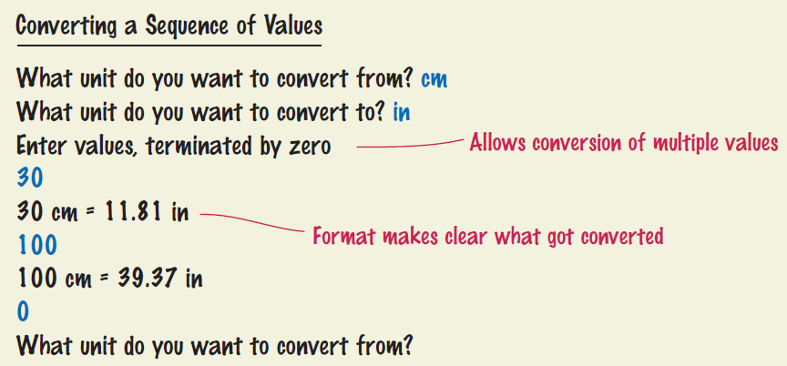
Storyboard Example
Goal: Converting a sequence of values
Will require a loop and some variables
Handle one conversion each time through the loop

Slide 40
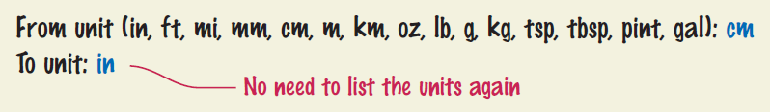
What Can Go Wrong?
Unknown unit types
What is the user misspells centimeters and inches?
What other conversions are available?
Solution:
Show a list of the acceptable unit types

Slide 41
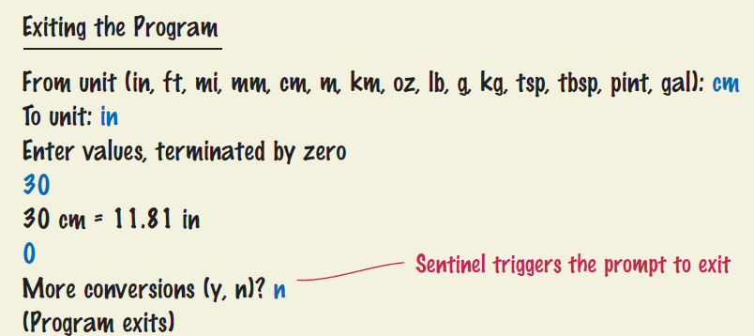
What Else Can Go Wrong?
How does the user quit the program?
Storyboards help you plan a program
Knowing the flow helps you structure your code

Slide 42
Common Loop Algorithms

Slide 43
Common Loop Algorithms
Sum and Average Value
Counting Matches
Prompting until a Match Is Found
Maximum and Minimum
Comparing Adjacent Values

Slide 44
Average Example
Average of Values
First total the values
Initialize count to 0
Increment per input
Check for count 0
Before divide!
total = 0.0
count = 0
inputStr = input("Enter value: ")
while inputStr != "" :
value = float(inputStr)
total = total + value
count = count + 1
inputStr = input("Enter value: ")
if count > 0 :
average = total / count
else :
average = 0.0

Slide 45
Sum Example
Sum of Values
Initialize total to 0
Use while loop with sentinel
total = 0.0
inputStr = input("Enter value: ")
while inputStr != "" :
value = float(inputStr)
total = total + value
inputStr = input("Enter value: ")

Slide 46
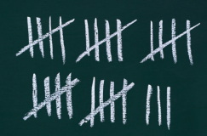
Counting Matches (e.g., Negative Numbers)
Counting Matches
Initialize negatives to 0
Use a while loop
Add to negatives per match
negatives = 0
inputStr = input("Enter value: ")
while inputStr != "“ :
value = int(inputStr)
if value < 0 :
negatives = negatives + 1
inputStr = input("Enter value: ")
print("There were", negatives, "negative values.")

Slide 47
Prompt Until a Match is Found
Initialize boolean flag to False
Test sentinel in while loop
Get input, and compare to range
If input is in range, change flag to True
Loop will stop executing
valid = False
while not valid :
value = int(input("Please enter a positive value < 100: "))
if value > 0 and value < 100 :
valid = True
else :
print("Invalid input.")
This is an excellent way to validate use provided inputs

Slide 48
Maximum
Get first input value
By definition, this is the largest that you have seen so far
Loop while you have a valid number (non-sentinel)
Get another input value
Compare new input to largest (or smallest)
Update largest if necessary
largest = int(input("Enter a value: "))
inputStr = input("Enter a value: ")
while inputStr != "“ :
value = int(inputStr)
if value > largest :
largest = value
inputStr = input("Enter a value: ")

Slide 49
Minimum
Get first input value
This is the smallest that you have seen so far!
Loop while you have a valid number (non-sentinel)
Get another input value
Compare new input to largest (or smallest)
Update smallest if necessary
smallest = int(input("Enter a value: "))
inputStr = input("Enter a value: ")
while inputStr != "“ :
value = int(inputStr)
if value < smallest :
smallest = value
inputStr = input("Enter a value: ")

Slide 50
Comparing Adjacent Values
Get first input value
Use while to determine if there are more to check
Copy input to previous variable
Get next value into input variable
Compare input to previous, and output if same
value = int(input("Enter a value: "))
inputStr = input("Enter a value: ")
while inputStr != "“ :
previous = value
value = int(inputStr)
if value == previous :
print("Duplicate input")
inputStr = input("Enter a value: ")

Slide 51
Grades Example
Open the file:
Grades.py
Look carefully at the source code.
The maximum possible score is read as user input
There is a loop to validate the input
The passing grade is computed as 60% of the available points

Slide 52
The for Loop

Slide 53
The for Loop
Uses of a for loop:
The for loop can be used to iterate over the contents of any container.
A container is is an object (Like a string) that contains or stores a collection of elements
A string is a container that stores the collection of characters in the string

Slide 54
An Example of a for Loop
Note an important difference between the while loop and the for loop.
In the while loop, the index variable i is assigned 0, 1, and so on.
In the for loop, the element variable is assigned stateName[0], stateName[1], and so on.
stateName = "Virginia"
i = 0
while i < len(stateName) :
letter = stateName[i]
print(letter)
i = i + 1
while version
stateName = "Virginia"
for letter in stateName :
print(letter)
for version

Slide 55
The for Loop (2)
Uses of a for loop:
A for loop can also be used as a count-controlled loop that iterates over a range of integer values.
i = 1
while i < 10 :
print(i)
i = i + 1
while version
for i in range(1, 10) :
print(i)
for version

Slide 56
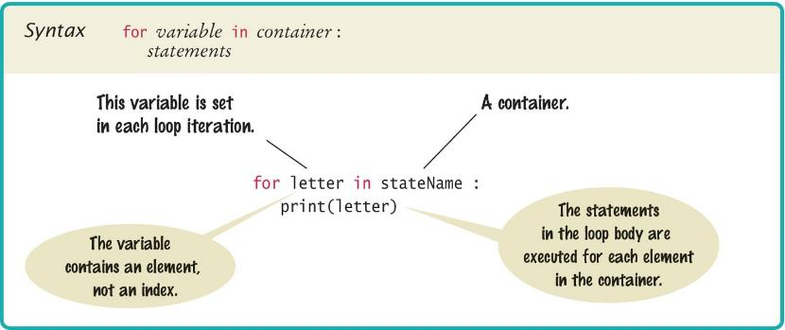
Syntax of a for Statement (Container)
Using a for loop to iterate over the contents of a container, an element at a time.

Slide 57
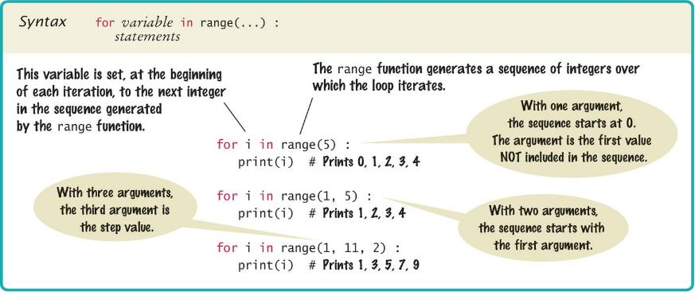
Syntax of a for Statement (Range)
You can use a for loop as a count-controlled loop to iterate over a range of integer values
We use the range function for generating a sequence of integers that less than the argument that can be used with the for loop

Slide 58
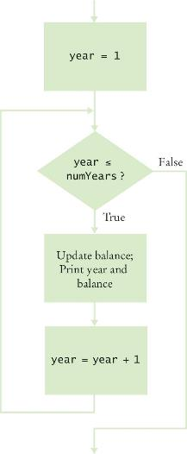
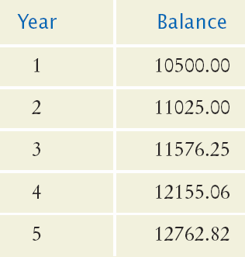

Planning a for Loop
Print the balance at the end of each year for a number of years

Slide 59
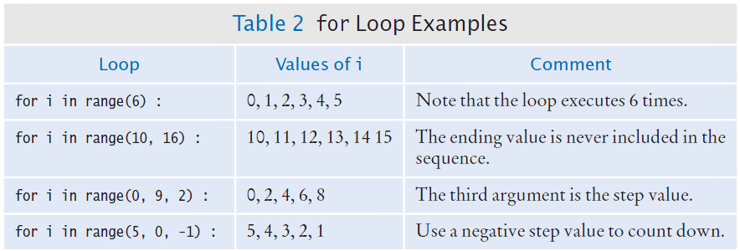
Good Examples of for Loops
Keep the loops simple!

Slide 60
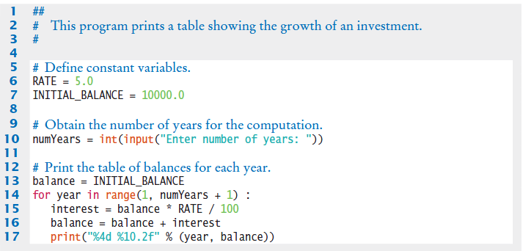
Investment Example

Slide 61
Programming Tip
Finding the correct lower and upper bounds for a loop can be confusing.
Should you start at 0 or at 1?
Should you use <= b or < b as a termination condition?
Counting is easier for loops with asymmetric bounds.
The following loops are executed b - a times.
int i = a
while i < b :
. . .
i = i + 1
for i in range(a, b) :
. . .

Slide 62
Programming Tip
The loop with symmetric bounds (“<=”, is executed b - a + 1 times.
That “+1” is the source of many programming errors.
i = a
while i <= b :
. . .
i = i + 1
# For this version of the loop the ‘+1’ is very noticeable!
for year in range(1, numYears + 1) :

Slide 63
Summary of the for Loop
for loops are very powerful
The for loop can be used to iterate over the contents of any container, which is an object that contains or stores a collection of elements
a string is a container that stores the collection of characters in the string.
A for loop can also be used as a count-controlled loop that iterates over a range of integer values.

Slide 64
Steps to Writing a Loop
Planning:
Decide what work to do inside the loop
Specify the loop condition
Determine loop type
Setup variables before the first loop
Process results when the loop is finished
Trace the loop with typical examples
Coding:
Implement the loop in Python

Slide 65
A Special Form of the print Function
Python provides a special form of the print function that does not start a new line after the arguments are displayed
This is used when we want to print items on the same line using multiple print statements
For example the two statements:
print(“00”, end=””)
print(3 + 4)
Produce the output:
007
Including end=“” as the last argument to the print function prints an empty string after the arguments, instead on a new line
The output of the next print function starts on the same line

Slide 66
Nested Loops

Slide 67
Loops Inside of Loops
In Chapter Three we learned how to nest if statements to allow us to make complex decisions
Remember that to nest the if statements we need to indent the code block
Complex problems sometimes require a nested loop, one loop nested inside another loop
The nested loop will be indented inside the code block of the first loop
A good example of using nested loops is when you are processing cells in a table
The outer loop iterates over all of the rows in the table
The inner loop processes the columns in the current row

Slide 68
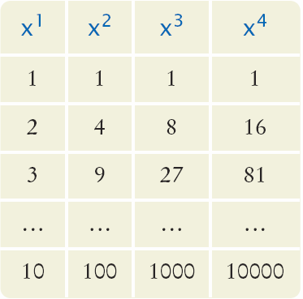
Our Example Problem Statement
Print a Table Header that contains x¹, x², x³, and x⁴
Print a Table with four columns and ten rows that contain the powers of x¹, x², x³, and x⁴ for x = 1 to 10

Slide 69
Applying Nested Loops
How would you print a table with rows and columns?
Print top line (header)
Use a for loop
Print table body…
How many rows are in the table?
How many columns in the table?
Loop per row
Loop per column
In our example there are:
Four columns in the table
Ten rows in the table

Slide 70
Pseudocode to Print the Table
Print the table header
for x from 1 to 10
print a new table row
print a new line
How do we print a table row?
For n from 1 to 4
print x^{n}
We have to place this loop inside the preceding loop
The inner loop is “nested” inside the outer loop

Slide 71
Pseudocode to Print the Table
Print the table header:
for x from 1 to 10
for n from 1 to 4
print X^{n}
print a new line
n ➔
x⬇

Slide 72
Flowchart of a Nested Loop
x = 1
x <= 10?
True
n= 1
Inner Loop
False
n <= 4?
True
Print x^{n}
False
n = n + 1
Print new line
x = x + 1
Done

Slide 73
Powertable.py
The end=“” suppresses the new line, so the numbers are all printed on the same line
Body of outer loop, x = 1 ➔ 10
Body of inner loop, n = 1 ➔ 4

Slide 74
The Results

Slide 75
First Exercise
Open the program:
powertable.py
Run the program and review the results
Make the following changes:
Change the value of NMAX to 6 and run the program
What changes in the table?
Change the value of NMAX back to 4
Change the value of XMAX to 4
What changes in the table?

Slide 76
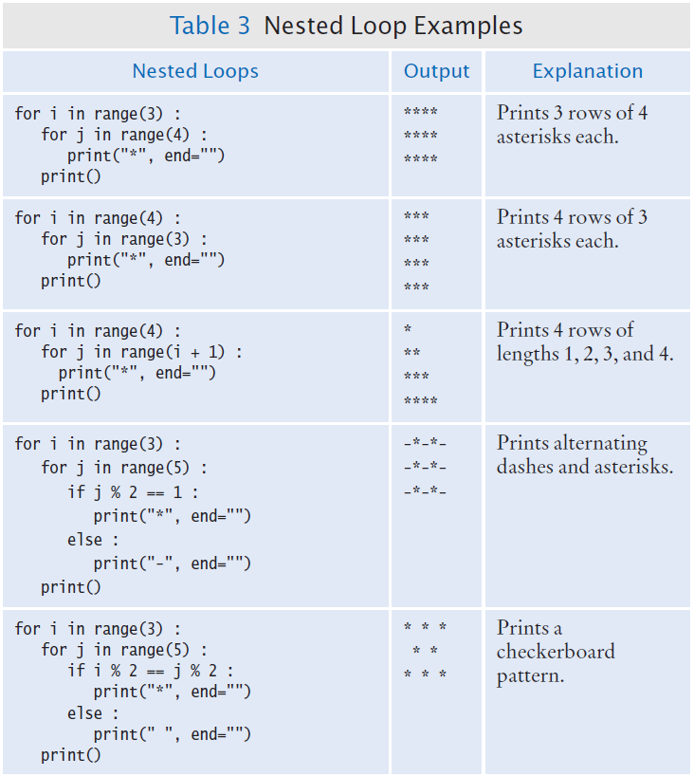
Nested Loop Examples

Slide 77
Hand Tracing the Loop
i will have the values:
0, 1, 2, 3 – So we will have four lines of stars
j will have the values
0 - So we will have one star
0, 1 - So we will have two stars
0, 1, 2 - So we will have three stars
0, 1, 2, 3 - So we will have four stars

Slide 78
Nested Loop Examples (2)

Slide 79
Second Problem Statement
Print the following pattern of brackets:
[][][][]
[][][][]
[][][][]
The pattern consists of:
Three rows
Each row has four pairs of brackets
What do we know?
We need two nested loops
The first loop (the outer loop) will print each of the three rows
The second loop (the inner loop) will print the four pairs of brackets

Slide 80
Pseudocode Code, Results
For i = 1 to 3
For j = 1 to 4
Print “[]”
Print a new line

Slide 81
Exam Averages Problem Statement
It is common to repeatedly read and process multiple groups of values:
Write a program that can compute the average exam grade for multiple students.
Each student has the same number of exam grades
Prompt the user for the number of exams
When you finish a student prompt the user to see if there are more students to process
What do we know?
What do we need to compute?
What is our algorithm / approach?

Slide 82
Step One: Understand the Problem
To compute the average grade for a student, we must read and tally all of the grades for that student
We can use a loop to do this. (we have working code to do this portion)
We need to compute grades for multiple students
That implies a set of nested Loops
The outer loop processes each student
The inner loop process the student’s grades

Slide 83
Step Two
Compute the grade for one student
Set up the variables and loop
We know how many grades to process, so we can use a count-controlled loop
total score = 0
For i in range (1, number of exams + 1) :
Read the next exam score
Add the exam score to the total score
Compute the exam average
Print the exam average

Slide 84
Step Three
Repeat the process for each student
Since we don’t know how many students there are, we will use a while loop with a sentinel value
For simplicity we will use “Y” as the sentinel value

Slide 85
Step Four: Translate to Python

Slide 86
Exam Averages Example
Open the file:
examaverages.py
Notice that the second loop (the for loop) is nested inside the while loop
In Wing you should see a line (the indent guide) connecting the for loop on line 17 down to the statement on line 21
The line is showing you the statements that are included in the for loop
If you don’t see the indent guide:
Click on the edit tab
Select “Preferences…”
Under Editor, select Indention
Click the “Show Indent Guides” box
Click the Apply button
Click the Okay Button

Slide 87
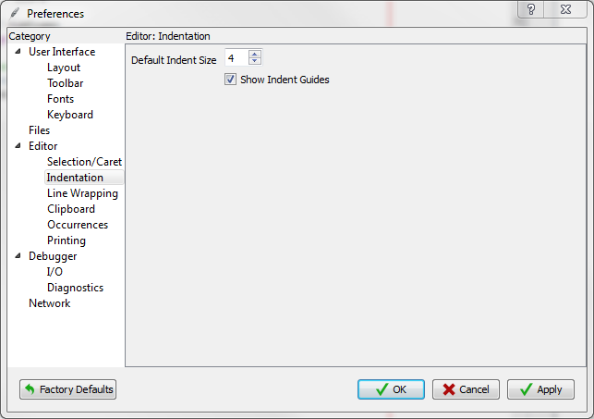
Turning the Indent Guides On

Slide 88
Processing Strings
A common use of loops is to process or evaluate strings.
For example, you may need to count the number of occurrences of one or more characters in a string or verify that the contents of a string meet certain criteria.

Slide 89
Processing Strings

Slide 90
String Processing Examples
Counting Matches
Finding All Matches
Finding the First or Last Match
Validating a String
Building a New String

Slide 91
Counting Matches
Suppose you need to count the number of uppercase letters contained in a string.
We can use a for loop to check each character in the string to see if it is upper case
The loop below sets the variable char equal to each successive character in the string
Each pass through the loop tests the next character in the string to see if it is uppercase
uppercase = 0
for char in string :
if char.isupper() :
uppercase = uppercase + 1

Slide 92
Counting Vowels
Suppose you need to count the vowels within a string
We can use a for loop to check each character in the string to see if it is in the string of vowels “aeiuo”
The loop below sets the variable char equal to each successive character in the string
Each pass through the loop tests the lower case of the next character in the string to see if it is in the string “aeiou”
vowels = 0
for char in word :
if char.lower() in "aeiou" :
vowels = vowels + 1

Slide 93
Finding All Matches Example
When you need to examine every character in a string, independent of its position we can use a for statement to examine each character
If we need to print the position of each uppercase letter in a sentence we can test each character in the string and print the position of all uppercase characters
We set the range to be the length of the string
We test each character
If it is uppercase we print I, its position in the string
sentence = input("Enter a sentence: ")
for i in range(len(sentence)) :
if sentence[i].isupper() :
print(i)

Slide 94
Finding the First Match
This example finds the position of the first digit in a string.
found = False
position = 0
while not found and position < len(string) :
if string[position].isdigit() :
found = True
else :
position = position + 1
if found :
print("First digit occurs at position", position)
else :
print("The string does not contain a digit.")

Slide 95
Finding the Last Match
Here is a loop that finds the position of the last digit in the string.
This approach uses a while loop to start at the last character in a string and test each value moving from the end of the string to the start of the string
Position is set to the length of the string - 1
If the character is not a digit, we decrease position by 1
Until we find a digit, or process all the characters
found = False
position = len(string) - 1
while not found and position >= 0 :
if string[position].isdigit() :
found = True
else :
position = position - 1

Slide 96
Validating a String
In the United States, telephone numbers consist of three parts––area code exchange, and line number––which are commonly specified in the form (###)###-####.

Slide 97
Validating a String (code)
We can examine a string to ensure that it contains a correctly formatted phone number. (e.g., (703)321-6753)
The loop test each character to see it it is correct for its position, or a number
valid = len(string) == 13
position = 0
while valid and position < len(string) :
valid = ((position == 0 and string[position] != "(")
or (position == 4 and string[position] != ")")
or (position == 8 and string[position] != "-")
or (position != 0 and position != 4 and position != 8
and string[position].isdigit())) :
position = position + 1

Slide 98
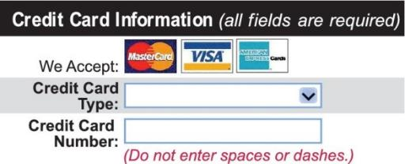
Building a New String
One of the minor annoyances of online shopping is that many web sites require you to enter a credit card without spaces or dashes, which makes double-checking the number rather tedious.
How hard can it be to remove dashes or spaces from a string?

Slide 99
Building a New String (code)
The contents of a string cannot be changed.
But nothing prevents us from building a new string.
Here is a loop that builds a new string containing a credit card number with spaces and dashes removed:
We read the credit card number
We initialize a new string to the empty string
We test each character in the user input
If the character is not a space or dash we append it to the new string
userInput = input("Enter a credit card number: ")
creditCardNumber = ""
for char in userInput :
if char != " " and char != "-" :
creditCardNumber = creditCardNumber + char

Slide 100
Application: Random Numbers and Simulations

Slide 101
Random Numbers/Simulations
Games often use random numbers to make things interesting
Rolling Dice
Spinning a wheel
Pick a card
A simulation usually involves looping through a sequence of events
Days
Events

Slide 102
Generating Random Numbers
The Python library has a random number generator that produces numbers that appear to be random
The numbers are not completely random. The numbers are drawn from a sequence of numbers that does not repeat for a long time
random() returns a number that is >= 0 and < 1

Slide 103
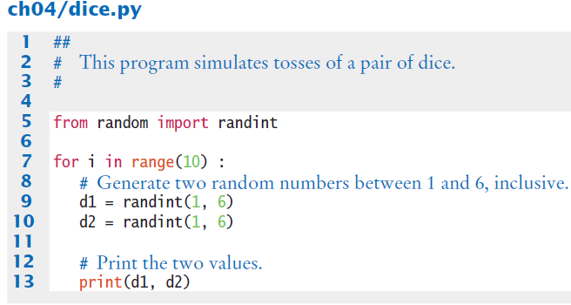
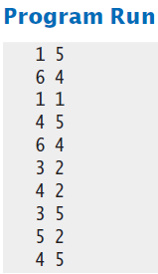
Simulating Die Tosses
Goal:
To generate a random integer in a given range we use the randint() function
Randint has two parameters, the range (inclusive) of numbers generated

Slide 104
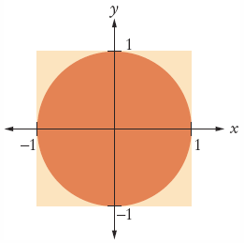
The Monte Carlo Method
Used to find approximate solutions to problems that cannot be precisely solved
Example: Approximate PI using the relative areas of a circle inside a square
Uses simple arithmetic
Hits are inside circle
Tries are total number of tries
Ratio is 4 x Hits / Tries

Slide 105

Monte Carlo Example

Slide 106
Graphics: Digital Image Processing

Slide 107
Manipulating Images
Digital image processing is the use of algorithms to manipulate digital images
It is used in:
Digital photography
Data compression
Computer graphics
Computer vision
Robotics
We’ll learn how to manipulate images with the ezgraphics package

Slide 108
Representing Images
A digital image is composed of pixels arranged in a grid of rows and columns
Computer images appear “smooth” because very small points on the screen (very close together) are used to reproduce the individual pixels
Pixels store data representing a color from the visual spectrum
The discrete RGB color model is the most used model
The three individual colors are specified by the amount of red, green, and blue light needed to produce a given color
The values are given as integers between 0 (no light present) and 255 (maximum light present)

Slide 109
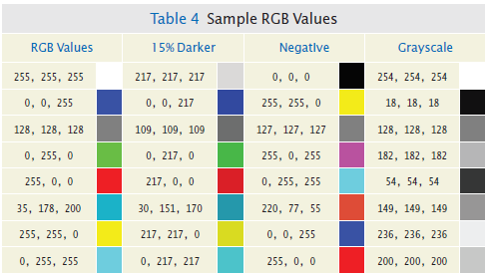
Filtering an Image
Filtering an image modifies the color component values of each pixel in some way

Slide 110
Processing an Image
We start by loading the image into our program
In ezgraphics an image is stored in an instance of the GraphicsImage class
from ezgraphics import GraphicsImage, GraphicsWindow
filename = "queen-mary.gif"
image = GraphicsImage(filename)
We draw the image on the canvas of a GraphicsWindow
win = GraphicsWindow()
canvas = win.canvas()
canvas.drawImage(image)
win.wait()

Slide 111
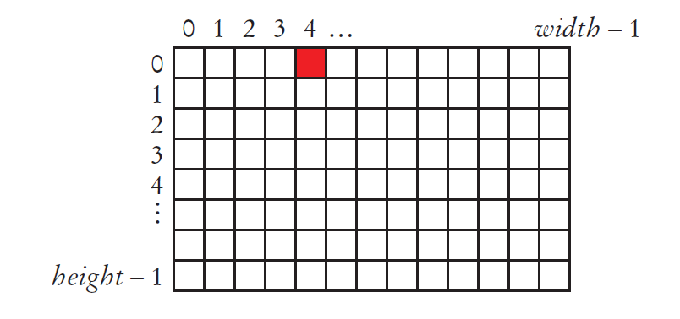
Filtering an Image
To filter an image, you must get the red, green, and blue component values for each pixel.
The pixels are organized into a two-dimensional grid of size width × height:
The rows and columns are numbered sequentially starting at 0, with pixel (0, 0) in the upper-left corner.
The row numbers range from 0 to height – 1; the column numbers from 0 to width – 1.

Slide 112
Accessing the Component Values of a Pixel
We use the getRed, getGreen and getBlue methods
red = image.getRed(0, 4)
green = image.getGreen(0, 4)
blue = image.getBlue(0, 4)
To create the negative of an image:
newRed = 255 - red
newGreen = 255 - green
newBlue = 255 – blue
And then update the pixel
image.setPixel(0, 4, newRed, newGreen, newBlue)

Slide 113
The Pseudocode
width = image.width()
height = image.height()
for row in range(height) :
for col in range(width) :
Get the current pixel color.
Filter the pixel.
Set the pixel to the new color.
image.save("negative" + filename)

Slide 114
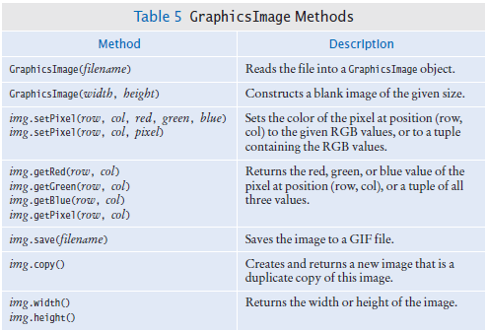
GraphicsImage Methods

Slide 115
Problem Solving: Solve a Simpler Problem First

Slide 116
Simplify a Complex Problem
As we learn more about programming, the complexity of the tasks we are solving increases
When we are faced with a complex task we should apply a critical skill:
Simplifying the problem and solving the simpler problem first
Our simplification (AKA problem decomposition) skills improve with practice

Slide 117

A Sample Problem
Our assignment is to arrange pictures, lining them up along the top edges, separating them with small gaps, and starting a new row whenever you run out of room in the current row.
This sounds simple, right?

Slide 118
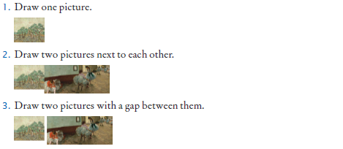
A Simple Plan
Let’s develop a plan that solves a set of simpler (increasing in complexity) problems

Slide 119
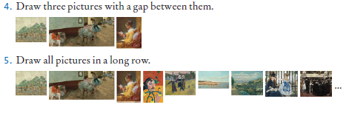
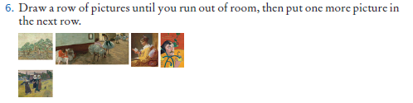
Increase the Complexity

Slide 120
Implementing Our Plan
Specify the canvas coordinates where the upper left corner of the first image should be placed
Then place the next picture after the first after the first
It needs to be drawn so that its left-most edge is positioned at the right-most x-coordinate of the preceding picture
This can be determined by obtaining the width of the first picture and using that value as the x-coordinate for the second picture
Separate the two pictures with a gap
To draw the third picture, it’s not sufficient to know the width of the preceding picture.
We also need to know the x-coordinate where it was drawn so we can add that value to the width of the preceding image, plus the gap between the images

Slide 121
Implementing our Plan
Now let’s put all of the pictures in a row
Load the pictures in a loop, and then put each picture to the right of the one that preceded it.
In each iteration, you need to track two pictures: the one that is being loaded, and the one that preceded it
We don’t want to have all pictures in a single row
The right margin of a picture should not extend past MAX_WIDTH
If the image doesn’t fit we need to put it on the next row, below all the pictures in the current row
We’ll set a variable maxY to the maximum y-coordinate of all placed pictures, updating it whenever a new picture is placed

Slide 122
Summary

Slide 123
Summary: Two Types of Loops
while Loops
for Loops
while loops are very commonly used (general purpose)
Uses of the for loop:
The for loop can be used to iterate over the contents of any container.
A for loop can also be used as a count-controlled loop that iterates over a range of integer values.

Slide 124
Summary
Each loop requires the following steps:
Initialization (setup variables to start looping)
Condition (test if we should execute loop body)
Update (change something each time through)
A loop executes instructions repeatedly while a condition is True.
An off-by-one error is a common error when programming loops.
Think through simple test cases to avoid this type of error.

Slide 125
Summary
A sentinel value denotes the end of a data set, but it is not part of the data.
You can use a boolean variable to control a loop.
Set the variable to True before entering the loop
Set it to False to leave the loop.
Loops can be used in conjunction with many string processing tasks

Slide 126
Summary
In a simulation, you use the computer to simulate an activity.
You can introduce randomness by calling the random number generator.

